Slide 1

Crop Rotation Advisor
ARTIFICIAL NEURAL NETWORK
CASE STUDY
Presenter Name:
R RAVINDER(BU22CSEN0300247)
K SWETHA(BU22CSEN0300529)
R BHAVYA SREE(BU22CSEN0300510)
U LIKITHA(BU22CSEN0300545)
Dept of Computer Science & Engineering AI-ML

Slide 2
Contents
Abstract
Introduction
Problem Statement
Objectives
Requirement Analysis
System Architecture
Design strategy
Status of implementation
Crop details
Results
Conclusion
Dept of Computer Science & Engineering AI-ML

Slide 3
Abstract
Continuous monocropping is a common agricultural practice that depletes soil fertility, leading to reduced yields and declining profits. Many farmers are unaware of the benefits of crop rotation, which can enhance soil health and long-term productivity.
Our AI-powered Crop Rotation Advisor analyzes:
Soil nutrients (NPK levels)
Climate conditions
Investment & profit per acre
Water availability & rainfall
By recommending alternative crops, this solution helps farmers adopt sustainable practices, improve soil fertility, and maximize profitability.
Dept of Computer Science & Engineering AI-ML

Slide 4
Problem Statement
Farmers in my village grow chilli (mirchi) every year, believing it guarantees high profits. However, continuous monocropping depletes soil fertility, reducing long-term yields. With high land rent (₹60,000 per acre) and limited awareness of crop rotation, farmers miss opportunities for better profits and sustainable farming. To solve this, our AI-powered Crop Rotation Advisor suggests alternative crops based on soil nutrients, climate, investment, and water availability, helping farmers improve soil health and maximize earnings.
Dept of Computer Science & Engineering AI-ML

Slide 5
Objectives
To develop an AI-based crop rotation recommendation system that suggests the best crops based on soil health, climate, and water availability.
To improve agricultural productivity and profitability by providing data-driven insights for sustainable farming practices.
Dept of Computer Science & Engineering AI-ML

Slide 6
Requirement Analysis
Hardware Requirements:
A computer with 8GB RAM
Processor: Intel i5
Software Requirements:
Operating System: Windows Family.
Programming Language: Python (for model development).
Frontend Development: HTML, CSS, JavaScript (for web interface).
Database: MongoDB
Backend Framework: Node.js
Dept of Computer Science & Engineering AI-ML

Slide 7
System Architecture
Data Collection & Preprocessing
ANN Model
Web Application Development
Prediction
Recommendation
Dept of Computer Science & Engineering AI-ML

Slide 8
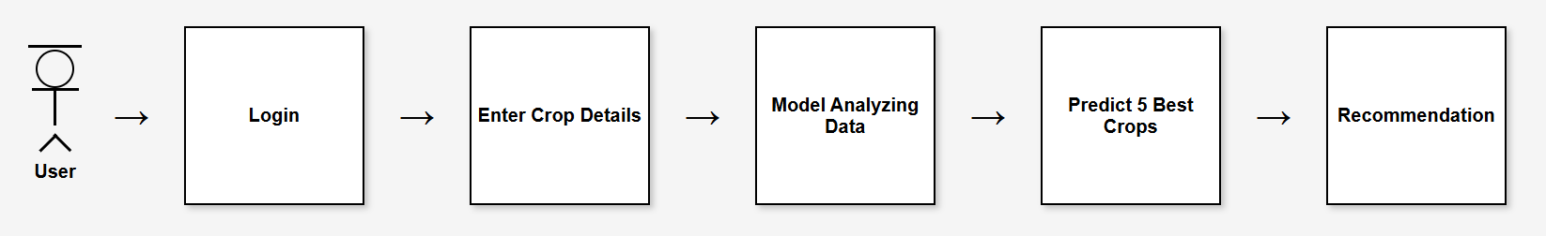
Design Strategy
Dept of Computer Science & Engineering AI-ML

Slide 9
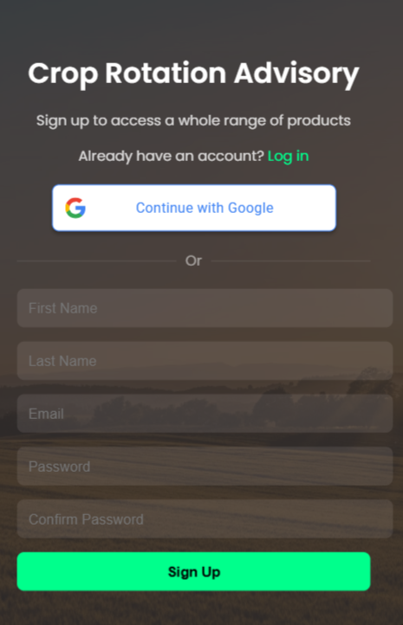

Status of Implementation
Register Page
User login the web application.
Dept of Computer Science & Engineering AI-ML

Slide 10
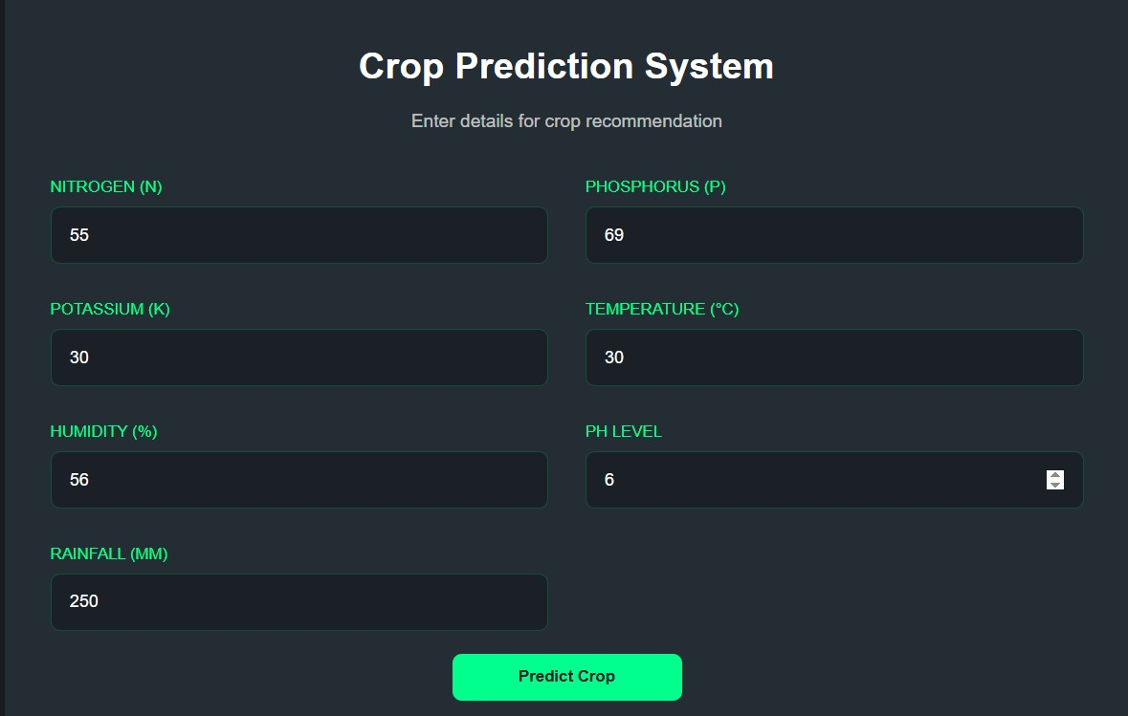
Crop Details
Dept of Computer Science & Engineering AI-ML

Slide 11
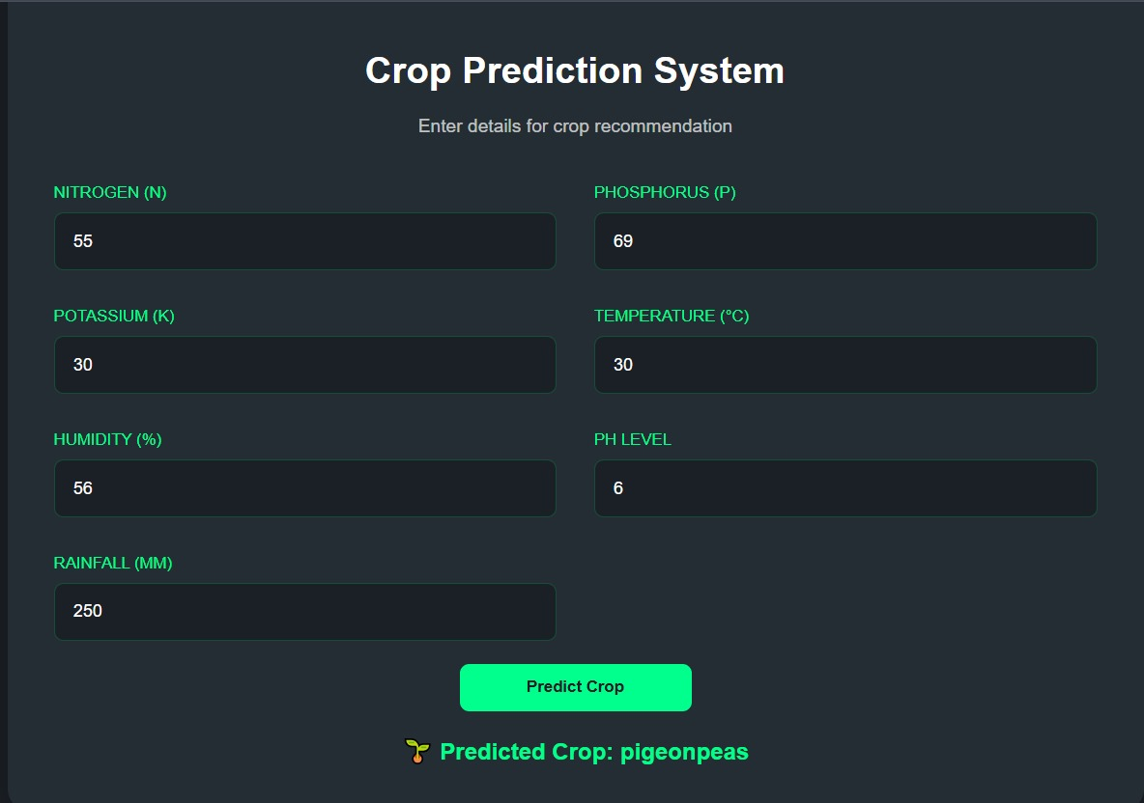
Results
Dept of Computer Science & Engineering AI-ML

Slide 12
Conclusion
Smart Crop Selection – The AI model predicts the best crops based on soil fertility, weather, water availability, and previous crops.
Better Resource Utilization – Helps optimize land, water, and fertilizers for sustainable farming.
User-Friendly Interface – A simple web-based interface allows easy data input and crop recommendations.
Dept of Computer Science & Engineering AI-ML

Slide 13
Thank You
Dept of Computer Science & Engineering AI-ML

